Slide 1

Online Bio-Informatics Toolkit
Architectural Spike Overview
Team 9: Benjamin Williams, Paul Ryu, Ansleigh Yancey, Sadaira Packer, Mason Monday

Slide 2
Client Problem
Large datasets need to be linked together to show how specific diseases interact with human tissues and cells
There is a lack of methods for organizing genetic variants for diseases, tissues, and cell types
Advanced computational methods and software are needed to create a database and online web server that can address these issues
Notes:
For our project, we are focusing on a database for genetic mutations for diseases and another for human genome signals

Slide 3
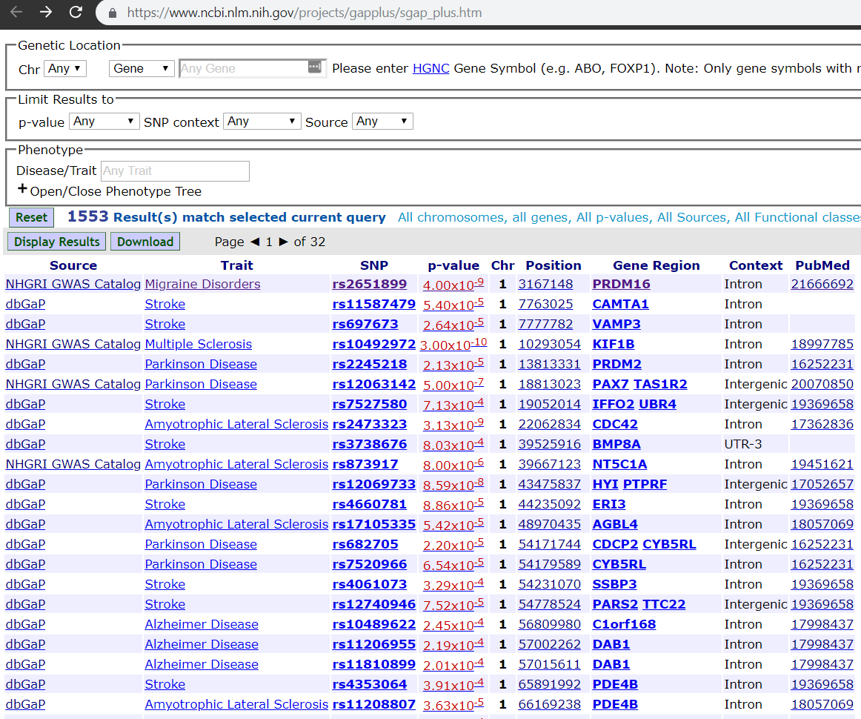
Dataset 1
National Center for Biotechnology Information
https://www.ncbi.nlm.nih.gov/projects/gapplus/sgap_plus.htm

Slide 4
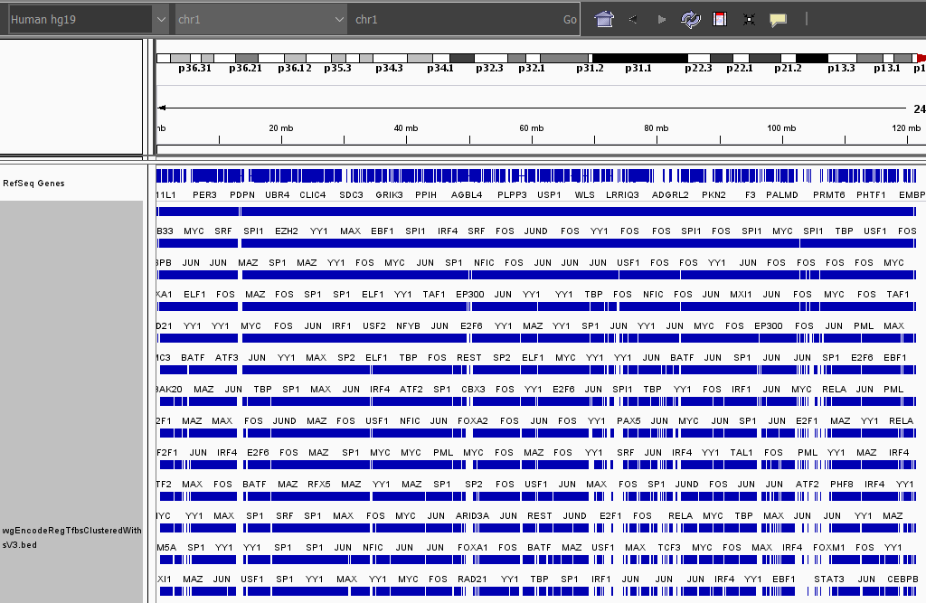
Dataset 2

Slide 5
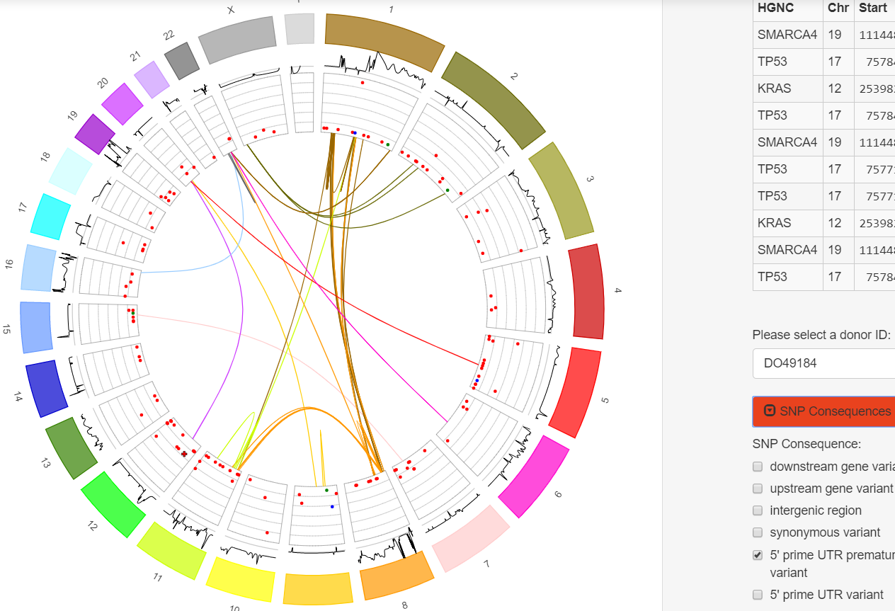
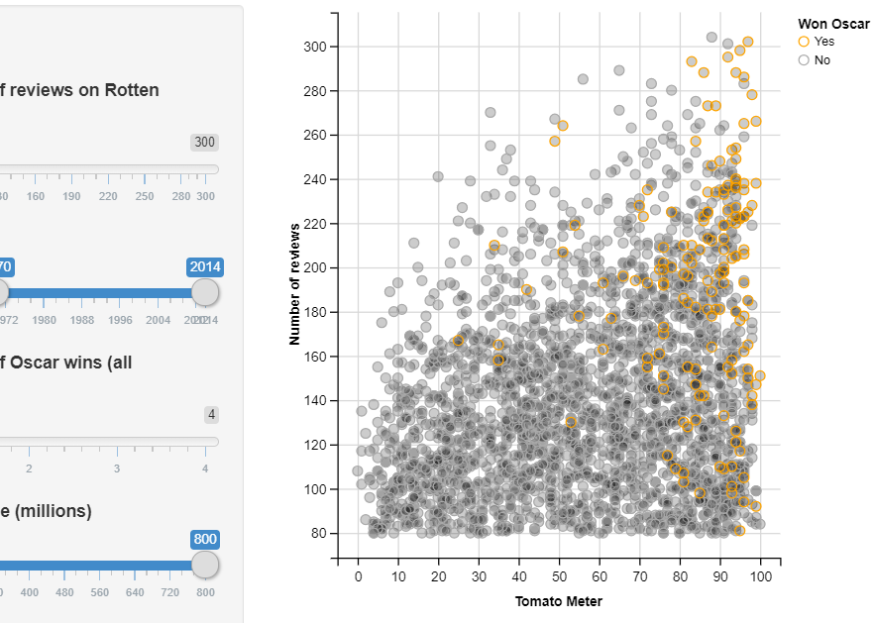
Our Solution
https://shiny.rstudio.com/gallery/genome-browser.html
Use programming language R
Utilize a R package named Shiny to create an interactive web application
Host the final product on a Shiny web-server for the client
https://shiny.rstudio.com/gallery/movie-explorer.html

Slide 6
User Stories
Add Entry
User can submit a request to add an entry in either the text box or by uploading a file (e.g. txt., .bed, etc.)
Only an administrator can add the entry
Delete Entry
User can submit a request to delete an entry but only the administrator can remove it
Edit Entry
User can submit a request to edit an entry but only the administrator can make changes to the entries
Search
by disease type
by tissue and cell lines

Slide 7
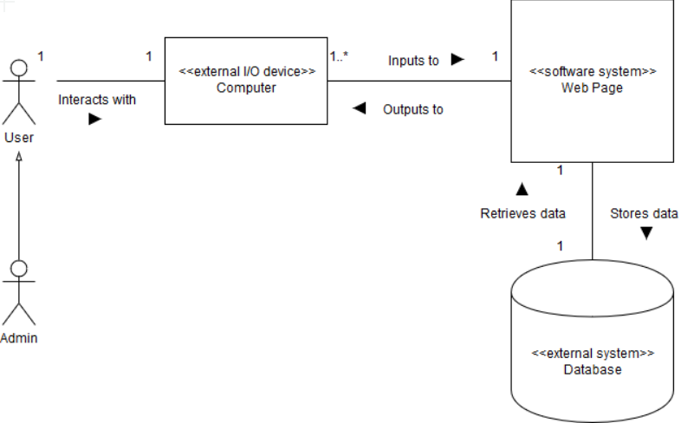
Design Description
Human genome data placed in a database that is linked to a web page hosted on the Shiny web server.
Users enter search criteria that gets sent to the database.
Data matching the search criteria is retrieved from the database and displayed to the user.
Users may also submit requests (adds, deletions, edits) that are held until they are approved by an administrator.

Slide 8
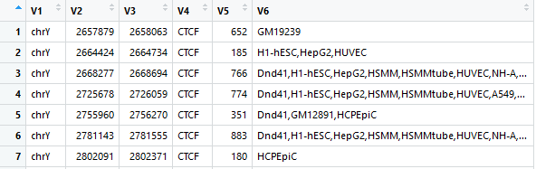
Technical Challenges
Inexperience with R, Shiny, and databases in general
Lack of biological knowledge required to comprehend the data itself

